Slide 1
Neural Network (Perceptrons)

Slide 2
Logistic Regression
Randomly initialize the w and b for z=w.x+b
Calculate the z for the initial w and b
Calculate the loss
Apply gradient descent to update the w and b
Repeat the process until convergence

Slide 3
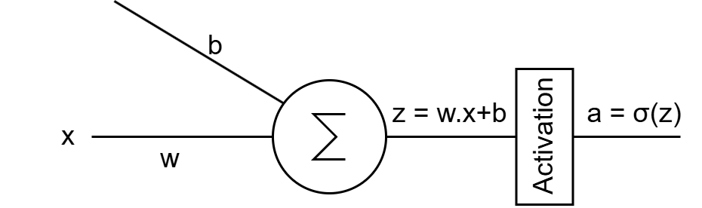
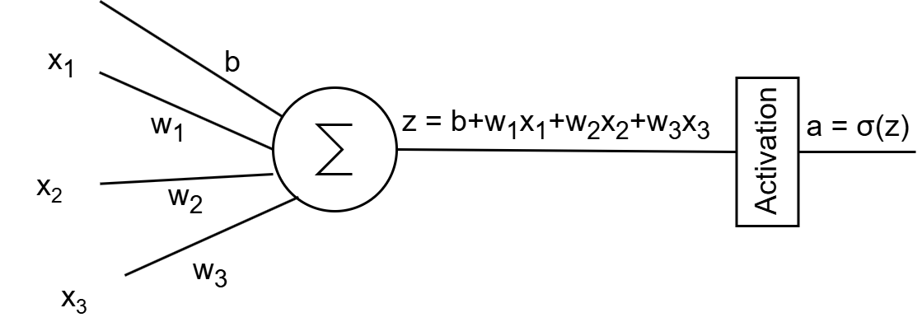
Logistic regression to neural networks
Logistic regression can be expressed as a single neuron neural network
Where, for a single feature and a single neuron, the network looks like:
For multiple features on a single neuron, the architecture may look like:
Single layer neural networks are referred to as perceptrons

Slide 4
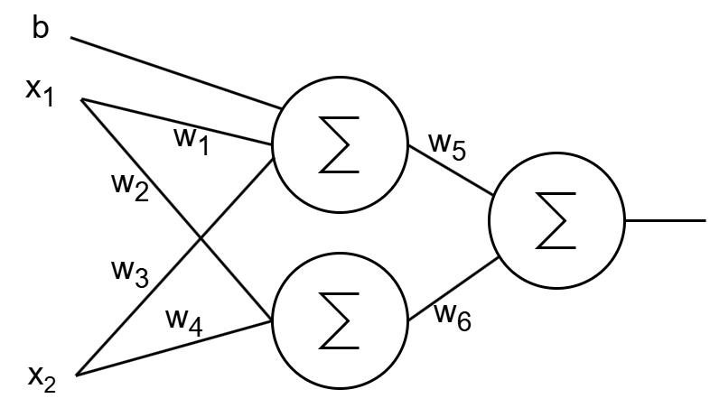
Logistic regression to neural networks
A network can involve multiple neurons
And it can become fairly large and complex

Slide 5
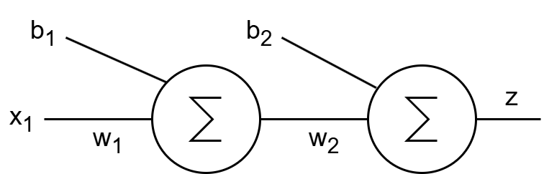
Neural networks
A method of processing based on multiple connected processing unit
Each neuron is a linear function, followed by a nonlinear activation function
The connectivity of the neurons build up a nested function
Can learn complex patterns
In the neural network above: z = σ(σ(x₁.w₁+b₁).w₂+b₂)
In a larger network, the function becomes much more nested and complex with many learnable parameters, giving it the ability to learn complex patterns
The learning process stays the same. After initialization, the weights {w₁, w₂, w₃,…, w_{n}} and biases {b₁, b₂, b₃,..., b_{m}} have to be updated through gradient descent

Slide 6

Why Neural Networks
Imagine a non-tabular datasets where FEATURES are not explicitly image
E.g. consider your cellphone’s face recognition module that works as a binary classification (is it your face or not)
How does the model learn to recognize your face? What are the features?
In neural networks (also called deep learning networks), we DO NOT need to explicitly mention the features, the model also learns which features are important by itself

Slide 7
Neural networks
The types of neural networks that we talked about until now is known as feedforward neural networks
There are also other forms of neural networks
Some of the basic types are:
Feedforward Neural Networks
Convolutional Neural Networks
Recurrent Neural Networks
Generative Adversarial Networks
Transformers
… and Many More!
For this lecture, we are going to talk about the feedforward networks only

Slide 8
Training a Neural Network
Collect dataset
Define the architecture of the Neural Network model that is to be trained on the data
Initialize all the weights and biases
Calculate output based on the initialized weights and bias, which is called forward propagation
Calculate loss using an appropriate loss function
Update the last layer weights and bias using the gradient of the loss
Propagate the gradient to update the backwards layers, known as backpropagation
Run in a loop until convergence

Slide 9
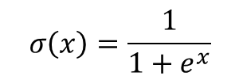


Activation Functions
Activation functions are used to introduce non-linearity
Sigmoid function:
Derivative:
ReLU function:
What is the derivative of ReLU(x)?

Slide 10
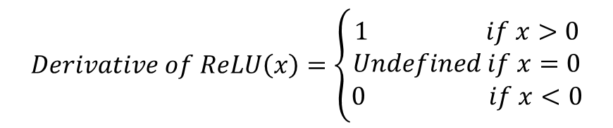
Activation Functions
Activation functions are used to introduce non-linearity
Sigmoid function:
Derivative:
ReLU function:
In practical cases we take the derivative as 0 or 0.5 if x = 0
There are other activation functions like Tanh, Softplus, etc

Slide 11
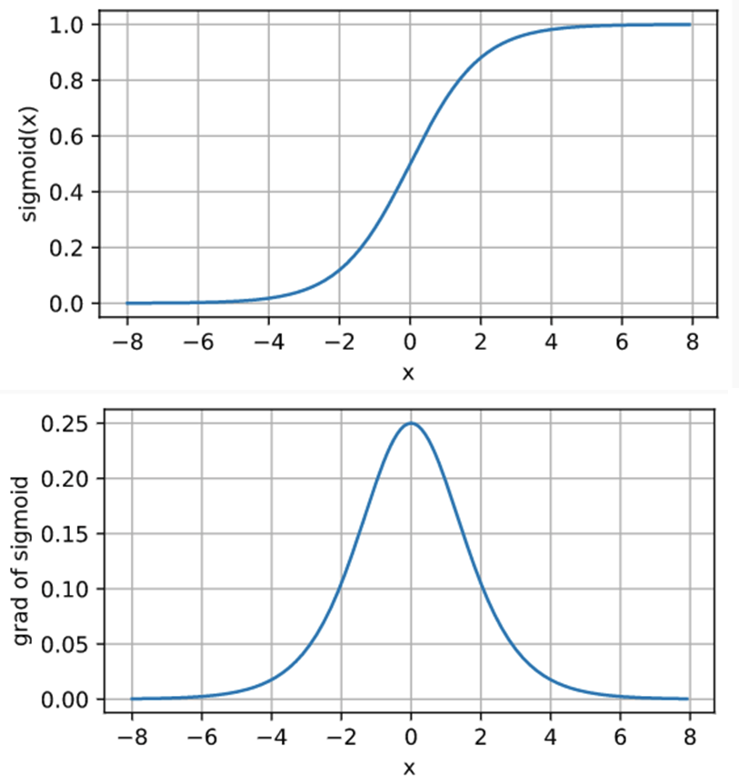
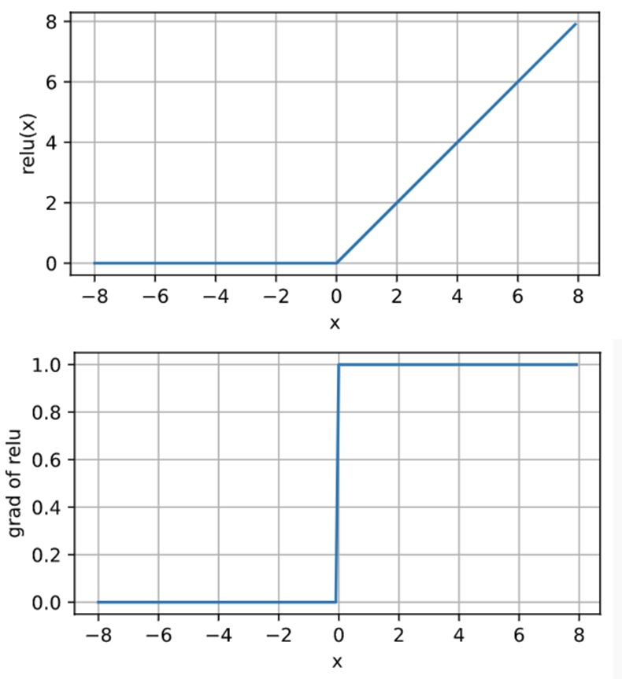
Activation Functions Graph

Slide 12

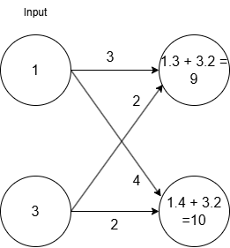
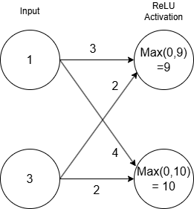
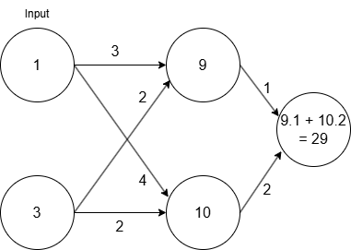
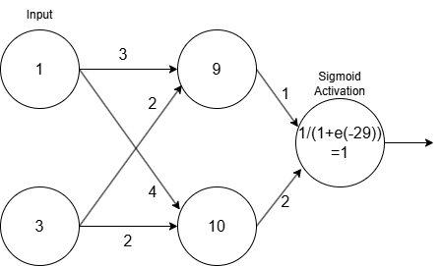
Forward Propagation

Slide 13
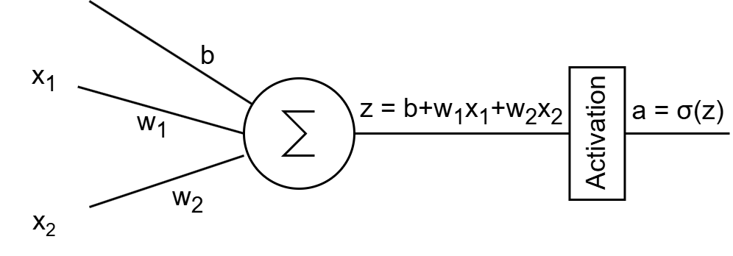
Back to the Single Neuron Perceptron
Here, there are two input feature values (x₁, x₂), output is (a)
The loss function discussed in the logistic regression can be used here, referred to as sigmoid loss function

Slide 14
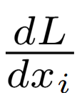
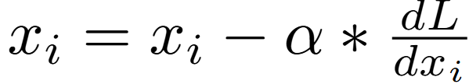
Update process
Calculate output a for all the data points in the dataset
Calculate loss for n number of data points using:
To update x_{ᵢ}, Calculate derivative of loss using
Update x_{ᵢ} using
Where, α is the learning rate
Update all the weights and biases in the network

Slide 15
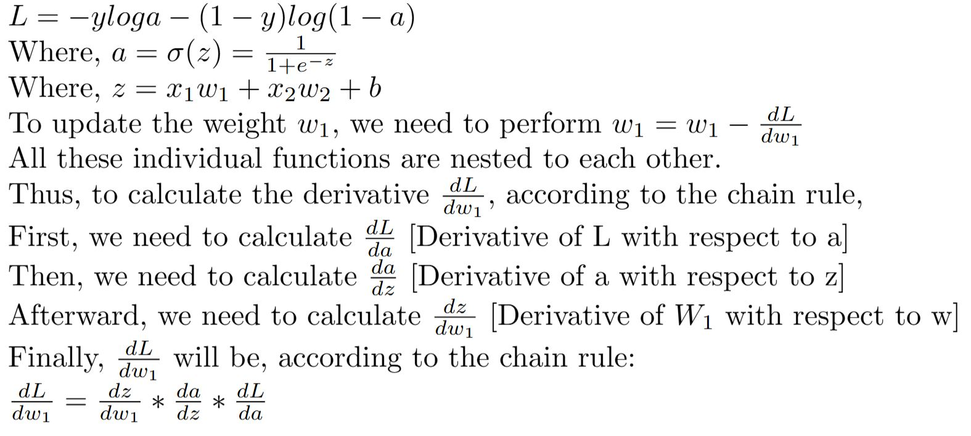
Gradient Calculation

Slide 16
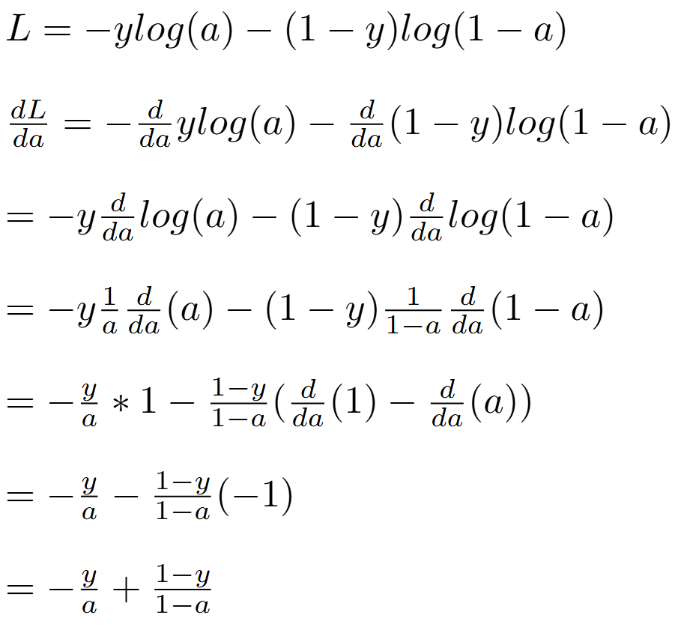
Let’s calculate the derivatives

Slide 17
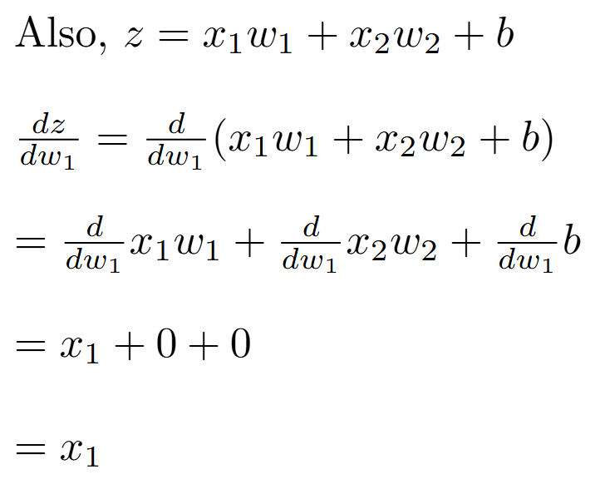
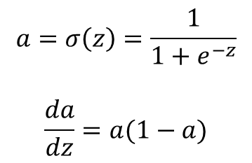
Let’s calculate the derivatives

Slide 18
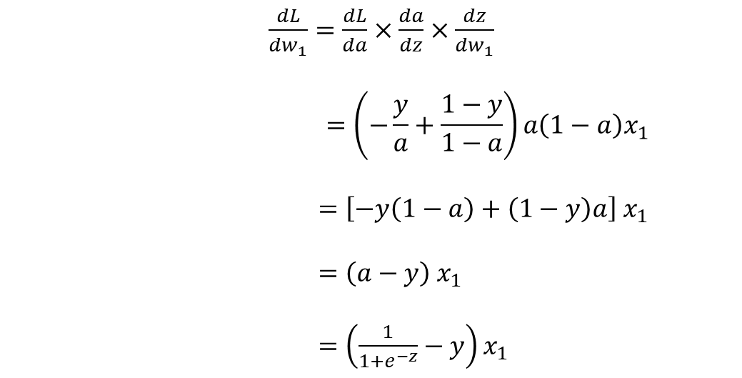
Let’s calculate the derivatives
Combining everything we get,

Slide 19


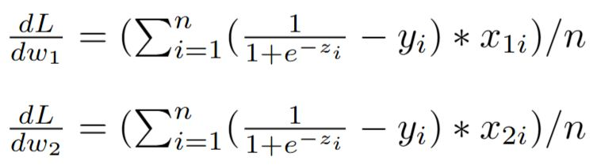

So, for a single neuron perceptron,
The gradient with respect to w₁ is,
The gradient with respect to w₂ would be,
This is for a single data point. For n number of samples, all the gradients have to be summed up and then averaged

Slide 20
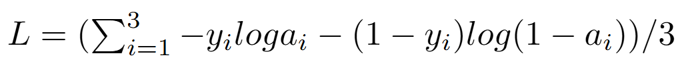
Some Basic Simulations
Let’s have a toy dataset
X | Y
.1 | 0
.2 | 0
.3 | 1
.4 | ?
We are trying to fit it with the following perceptron
w and b are the unknowns, which have to be figured out
For three data points, the loss function is:

Slide 21
Initializing,
W = .7
b = .1
Thus, z = .7x+.1
As the weights are randomly initialized, it should not fit our data points well, resulting in large error.
Let’s calculate the error through the loss function
(Please note that we should use the normalized version of all the values for faster and appropriate convergence. For simplicity, we are ignoring that step here.)

Slide 22
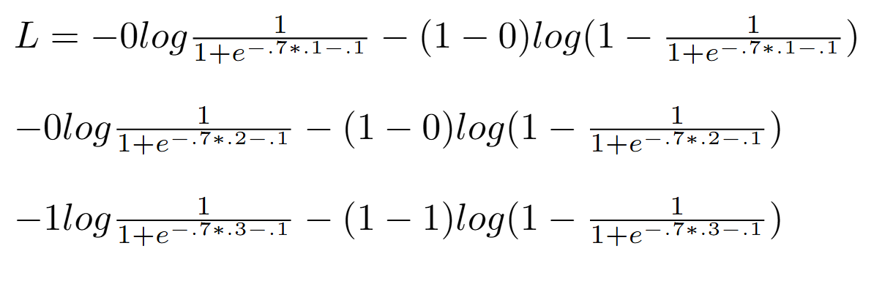
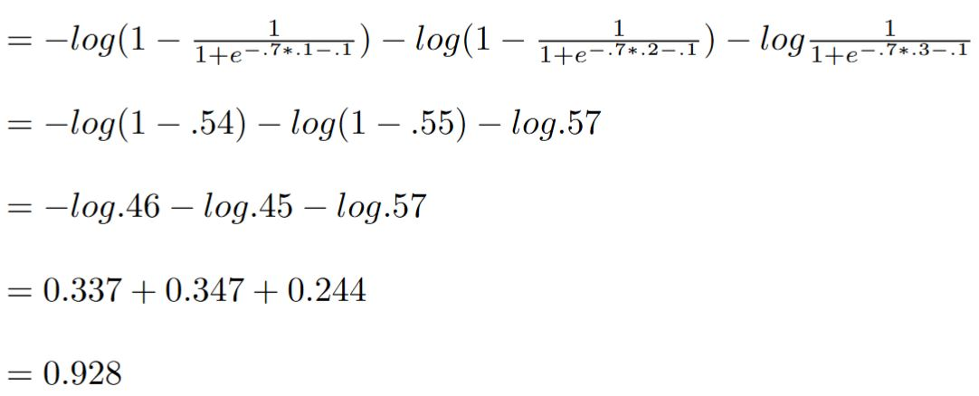
Now, calculating the sum of loss for the three points in the dataset:
[For the first data point]
[For the second data point]
[For the third data point]
Average loss value across the three data points is 0.928/3 = 0.309

Slide 23
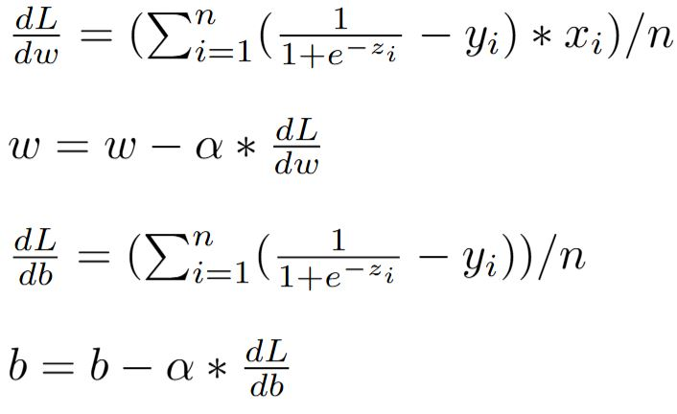
Let’s try to reduce the loss value
We’ll have to update both w and b using:
Where, α is the learning rate

Slide 24
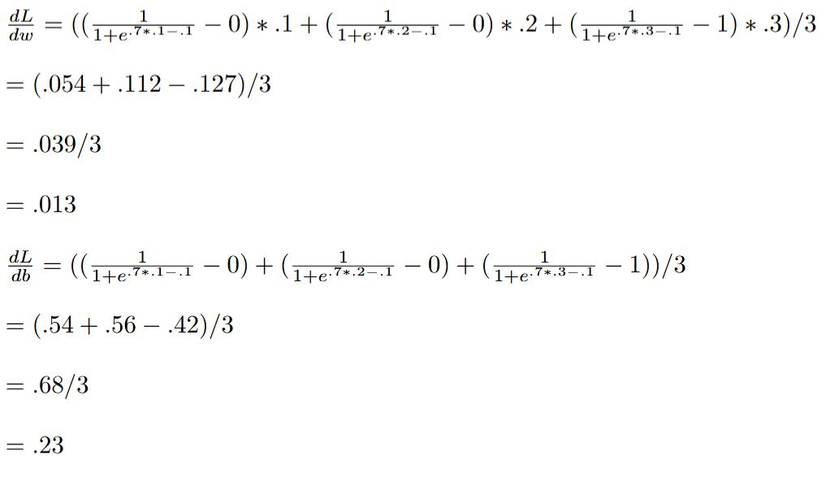
Thus, if α=1, the updated w and b are:
w = .7 - 1 * .013 = 0.687
B = .1 - 1 * .23 = -0.13

Slide 25
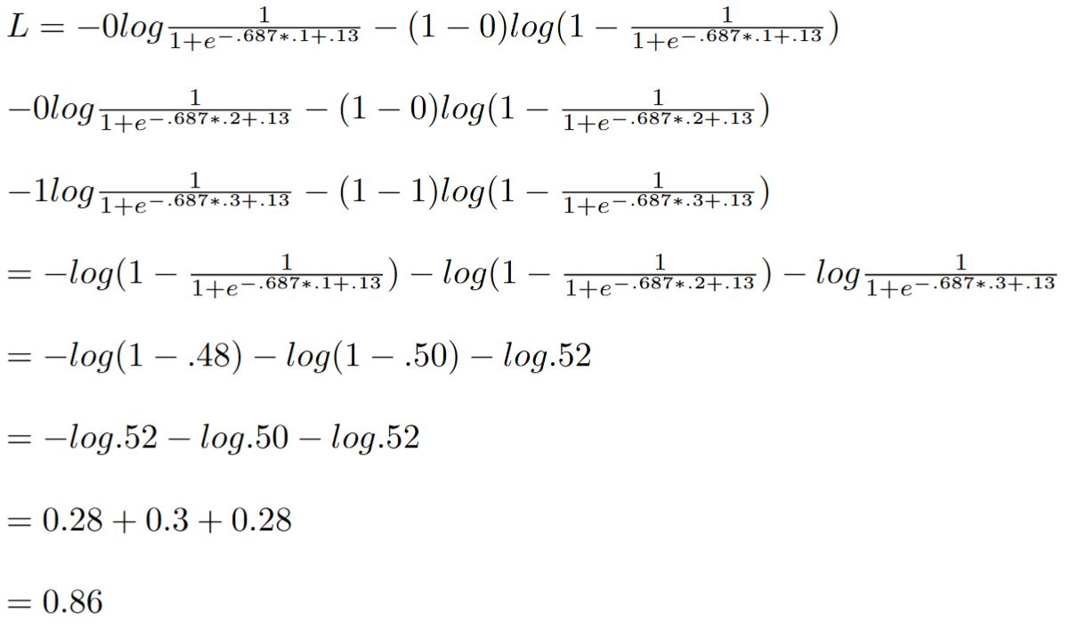
Recalculating the sum of loss:
Average = 0.86 / 3 = 0.287
Slightly better than before!
We need to run this many times in a loop to get further improvements. (Depending on the nature of data, good enough convergence might not be possible.)

Slide 26
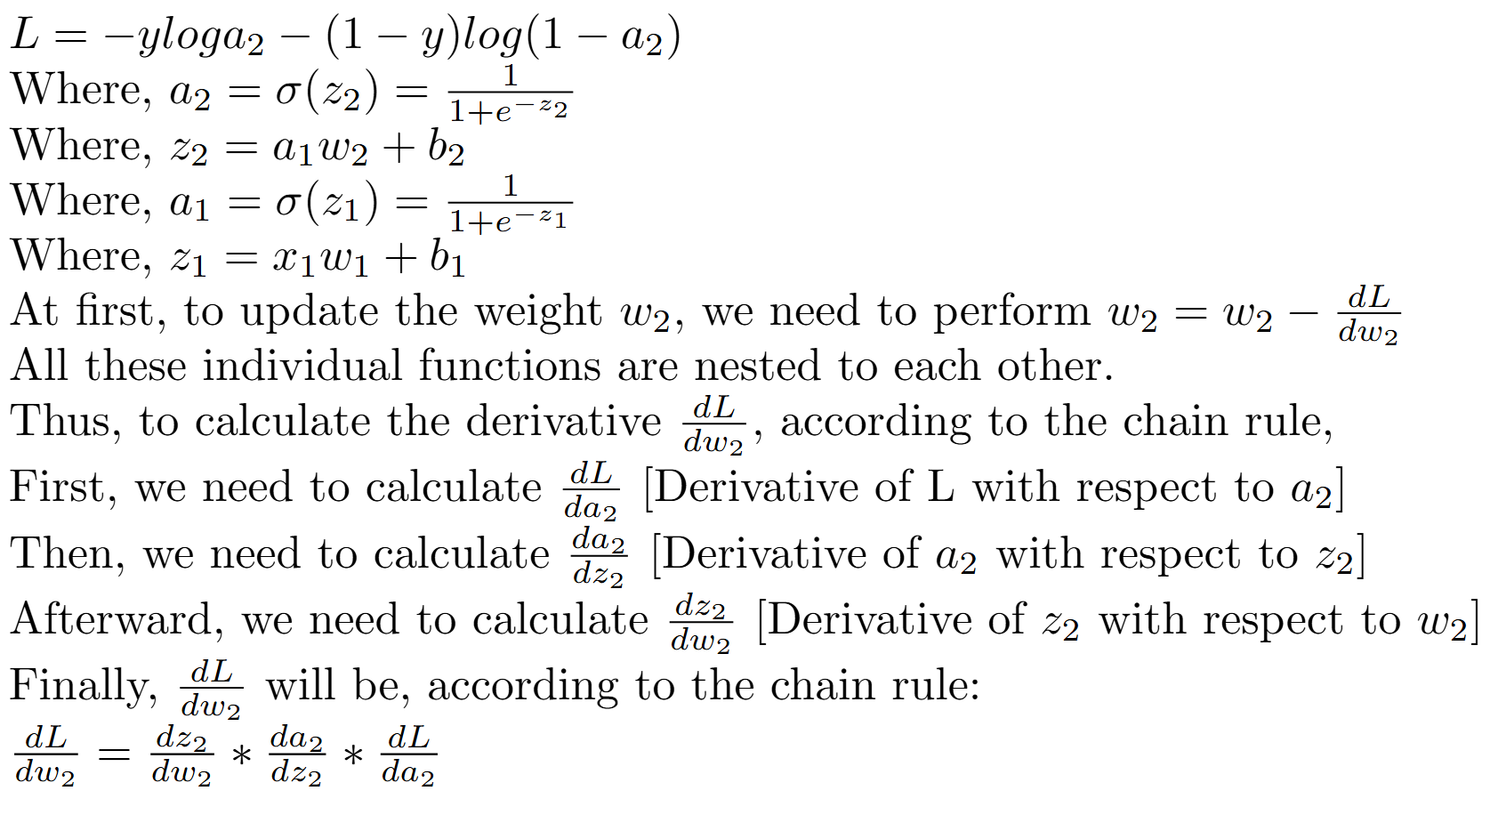
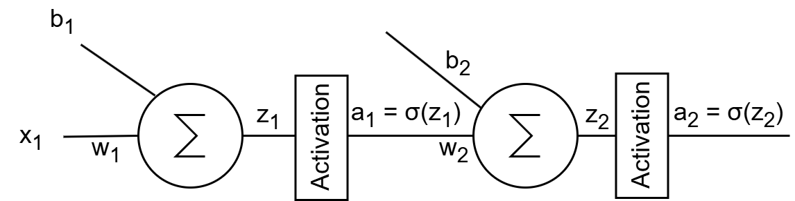
But what about a larger network?

Slide 27
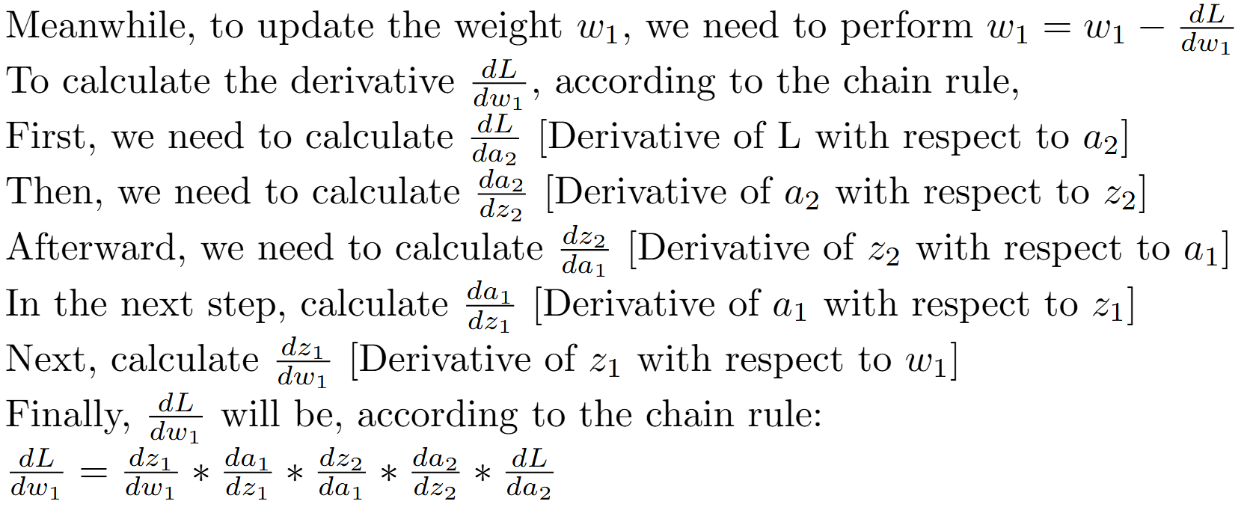

Slide 28

This is a fairly large differentiation and, with increasing layer count, can very quickly go out of hand. But wait…
While calculating the derivative w.r.t. w_{1,} the red-marked portion has already been calculated. We can just get the numerical values and plug them in.
For the gradient of each of the layer, we just need to store the gradient value for the earlier layer and plug them in, making the derivative calculation process much simpler.
In such a case, we are just propagating the gradient back from the later layer, hence the name ‘backpropagation’.

Slide 29
No matter how complex an expression is, it can be broken down into simple arithmetic expressions.
It is possible to easily calculate the derivative of these individual simple expressions, get their values, apply chain rule repeatedly, and plug them in to the earlier operation from the later operation.
This method is known as automatic differentiation and is capable of calculating all the gradients in a single backward swoop.
This is how deep learning libraries are capable of calculating derivatives even in very complex networks.
Some other differentiation alternatives would be symbolic differentiation (can become too complex in a large network) and numerical differentiation (not very accurate).

